Slide 1

Beach Investments
Chris Bashall Data Science Corp

Slide 2

The Problem
Looking for a location to invest
Scarborough beach is a growing area but is it the correct location to invest?

Slide 3
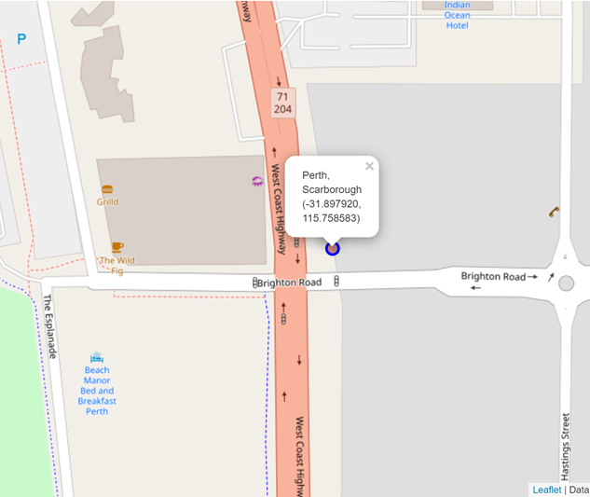
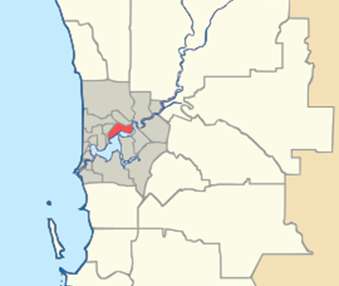
The Location
Scarborough Beach Precinct
Perth City

Slide 4
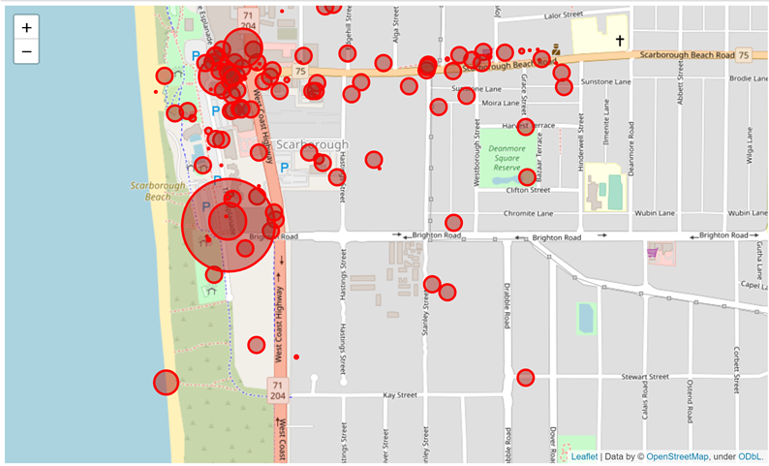
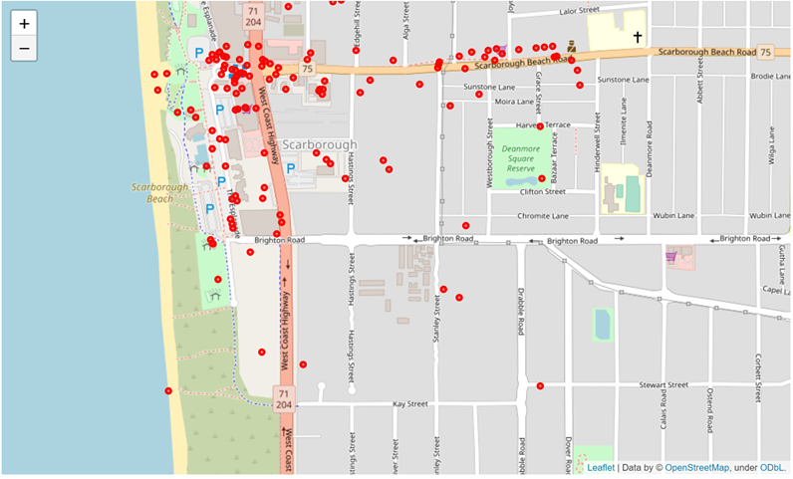
Other Venues
Popularity of nearby Venues
Locations of other Venues

Slide 5
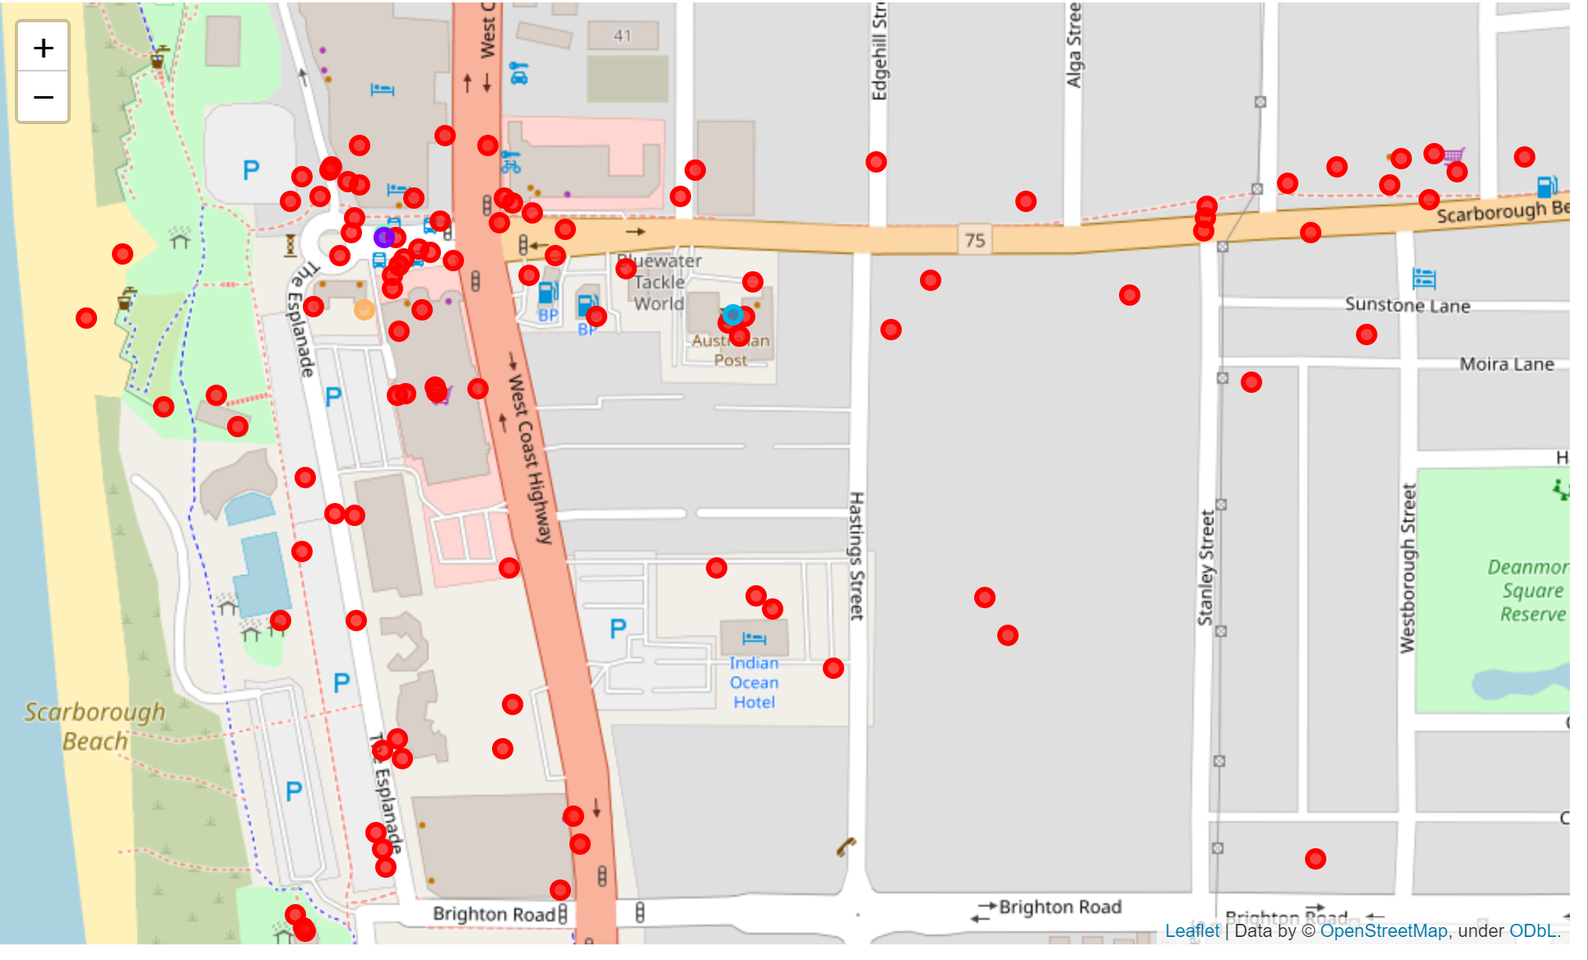
Prediction of Venue Clusters Locations
Cluster Locations
From the mapping it can be seen that none of the clusters are even close to the proposed investor location meaning this would be relying on a unique feature rather than on foot traffic / business from proximity to other businesses. The clusters can clearly be demonstrated closer to norther beach location.
The location of popular or liked venues also supports this argument as although there are some closely located popular venues, the majority of “likes” are located closer to the cluster locations again reduce these as a impact for success of the location
Cluster Locations
Proposed Location

Slide 6

Summary
The recommendation would be to explore other location and opportunity as well as to uncover specifically what the vendor feels drives the supposed success of this location as the data shows that it isn’t due to proximity of other venues or a “precinct” effect.
There are a number of clusters of business which are popular which are closer to the norther end and this may be a better area to explore opening a new business
While we are using data from a well-documented location, we are also bias as we are only exploring it from one source. For a deeper analysis I would recommending at using another data source to complement these findings

Slide 7





Thank You
Chris Bashall
+1 23 987 6554
chris@email.com
www.fabrikam.com

